Slide 1
Calendar
Logan Benner, Nathan Bitzko, Emily Blomstrand, Thomas Ruff

Slide 2
The Calendar
Our calendar allows the user to keep track of their schedule. Each month shows the days and how many currently scheduled events are kept, and the user can switch to view a specific week of the month if they wish. By clicking on a day, they can bring up the daily schedule. Through each day, the user can add or remove events to adjust their schedule. The calendar will also persist after closing and reopening the app.

Slide 3
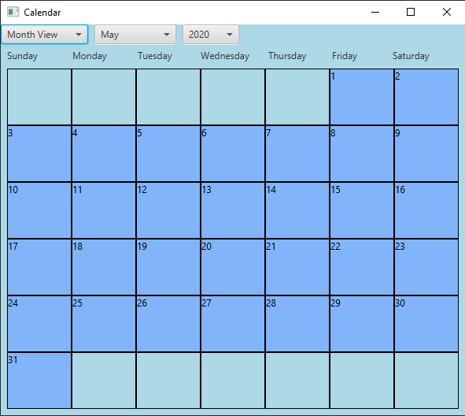
The default view, which reads the system for the current month and year

Slide 4
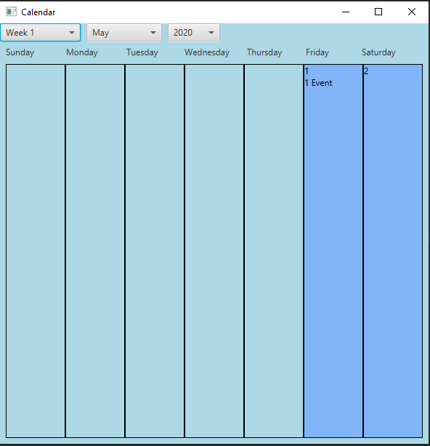
Using the leftmost selector, can switch to view a particular week of the month

Slide 5
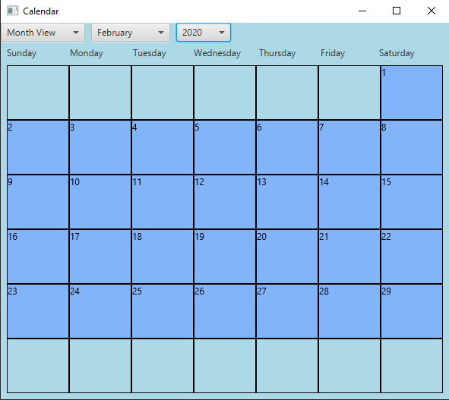
Different months highlight the correct days, and account for leap years

Slide 6
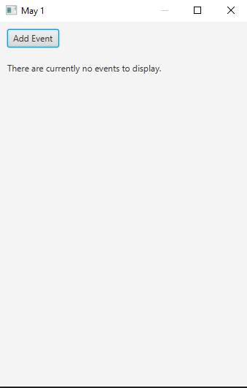
When a day is clicked with no events, a blank schedule is shown

Slide 7
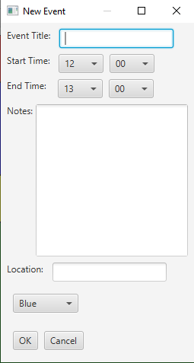
The Add Event button allows a user to enter these specifications

Slide 8
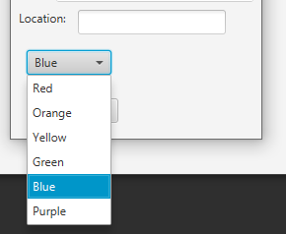
The color selector allows the user to color code their events to be displayed

Slide 9
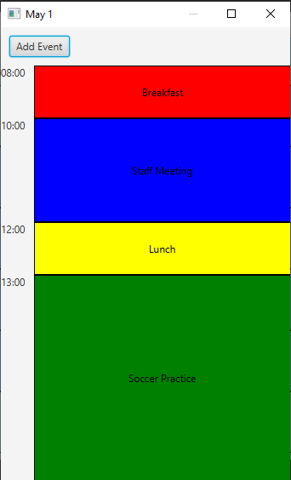
Wow Factor: Color-Coded
Events
A full schedule shows the desired colors, and scales blocks to their duration
Breakfast is an hour and starts at 8, while the staff meeting is at 10 and lasts 2 hours
Soccer practice is 4 hours!

Slide 10
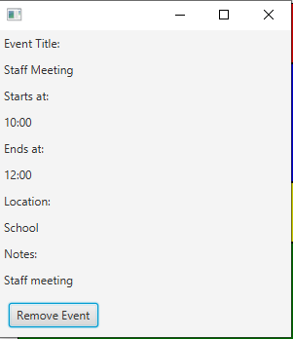
When an event is clicked, these details are brought up

Slide 11
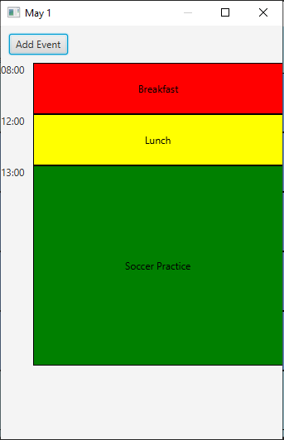
If the staff meeting is canceled, we can remove it and events stay in sorted order

Slide 12
Save State
When the Calendar starts, if no save file is detected, a new file is made. This is maintained so that each time the calendar is opened, the same events are found.

Slide 13

Thank you

